Slide 1
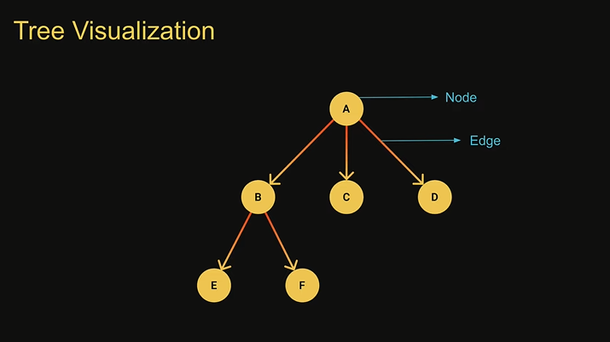
Tree
A tree is an hierarchical data structure that consists of nodes connected by edges
A tree is a non- linear data structure, compared to arrays, linked lists, stacks and queues which are linear data structure
In linear data structures the time required to search is proportional to the size of the data set.
Trees however owing to the nonlinear nature allow quicker easier access to the data
A tree will not contain any loops or cycles
Tree Usage
File System for directory structure
A family Tree
An organization tree
DOM
Chat Bots
Abstract syntax trees

Slide 2
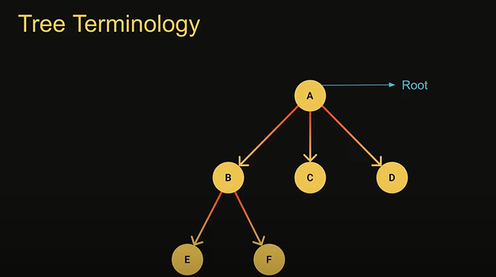
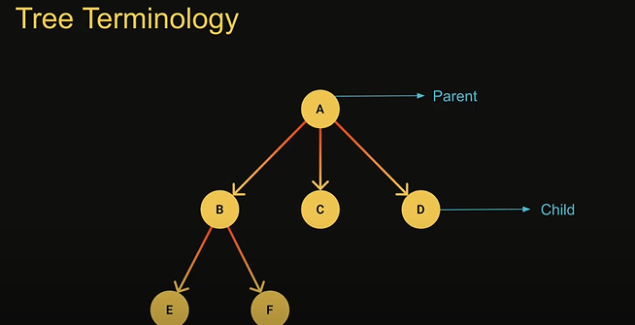
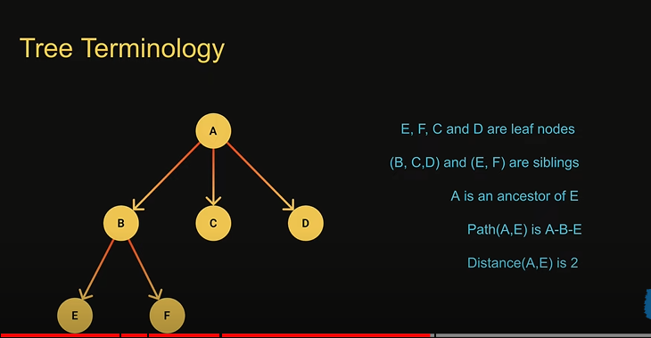
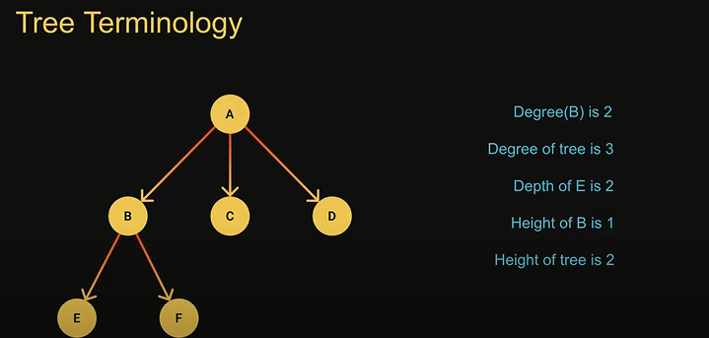

Slide 3
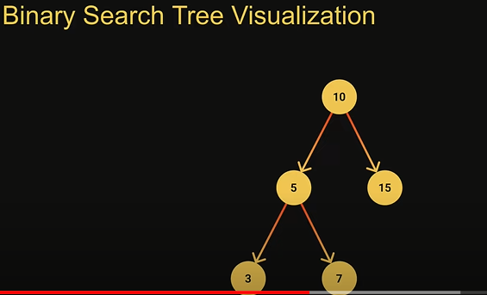
Binary Search Tree
A binary tree is a tree data structure in which each nodes has at most two children
They are refereed as left child and right child
The value of each left node must be smaller than the parent node
The value of each right node must be greater than the parent node
Binary search tree operations
Insertion – to add a node to the tree
Search – to find a node given its value
DFS & BFS – to visit all nodes in the tree
Deletion – to remove a node given its value
Binary search tree usage
Searching
To implement abstract data types such as lookup and prioritu queues

